Slide 1

Kaiser Permanente's Approach to ARTS
ACES, Resilience, Trauma-Informed Care & Social Determinants of Health
Julie Law, MD
Kaiser Permanente North Valley Service Area
General Pediatrician & Assistant Chief, Rancho Cordova
Co-Chair, Child Abuse Services & Prevention Team (CASP)
Co-Lead, Pediatric ARTS

Slide 2
OVERVIEW
background
01
Our local communities
02
Arts for pediatrics
03
LESSONS LEARNED
&
FUTURE STEPS
04

Slide 3
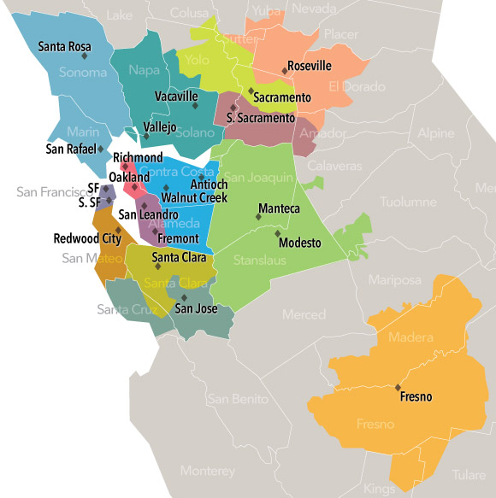
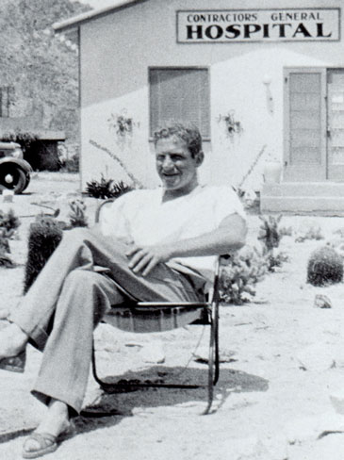
Preventive Care as a Philosophy
Mission – provide high-quality, affordable health care services, and to improve the health of our members and the communities we serve.
1933
Dr. Sidney Garfield set up a small practice in the Mojave Desert.
1938
Dr. Garfield cared for Coulee dam workers hired by Henry J. Kaiser. They started a family plan and a new concept – preventative care.
1945
The Permanente Health Plan was founded.
1953
Kaiser Permanente was formed.
2022
KP serves 12.6 million members nationally, 4.6 million in NorCal, 712K in North Valley (Roseville & Sacramento)
Notes:
Part 1: Background – KP’s philosophy of preventative medicine
1933: Fresh out of medical school, he “soon found myself in rather serious financial difficulty. Knowing nothing about medical economics, I had tackled the impossible job in those days of trying to take care of a group of workers with none of the usual crutches.” He worked out a new deal to be prepaid 5 cents/day per worker, while guaranteeing their medical care.
1938: At Coulee Dam he found very sick people with terminal pneumonia, ruptured appendices, diphtheria. They started a family plan to take care of women & children. Diphtheria disappeared completed with vaccines. People came in earlier for care; diseases were prevented.
1945: to provide an affordable, high quality health plan for working families, based on pre-payment & group medical practice.
https://about.kaiserpermanente.org/our-story/our-history/our-founders
https://about.kaiserpermanente.org/our-story/our-history/how-it-all-started
https://about.kaiserpermanente.org/our-story/our-history/dr-sidney-garfield-on-medical-care-as-a-right
https://about.kaiserpermanente.org/who-we-are/fast-facts
https://about.kaiserpermanente.org/who-we-are#:~:text=Mission,and%20the%20communities%20we%20serve.

Slide 4
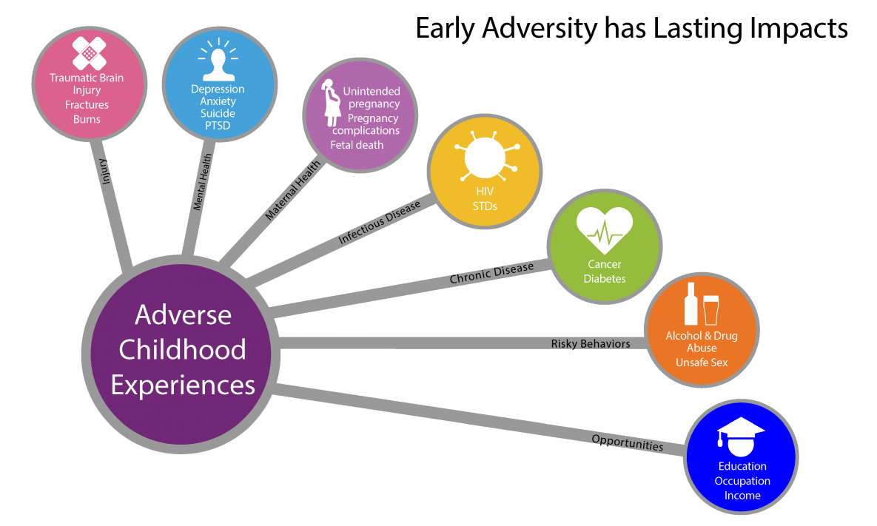
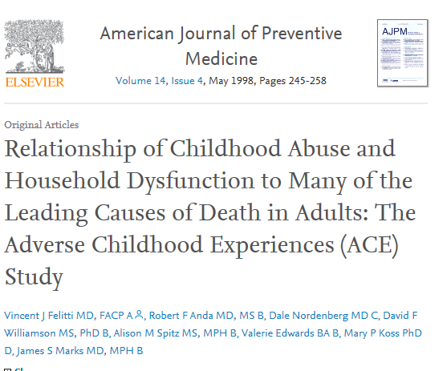
The CDC-KP ACES Study
Participants: > 17,000 adults who had a physical at KP SoCal between 1995-97.
Methods: confidential surveys of 7 categories of adverse childhood experiences, their current health status and behaviors.
Results:
Conclusions:
“We found a strong graded relationship between the breadth of exposure to abuse or household dysfunction during childhood and multiple risk factors for several of the leading causes of death in adults.”
Notes:
Slide courtesy of Yvonne Otani
>50% > 1 ACE, 25% > 2 ACES
4+ ACES → significantly increased risk of alcoholism, drug abuse, depression, SI attempts, smoking, self-rated poor health, > 50 sexual partners & STDs, sedentary behavior & obesity → graded relationship to adult ischemic heart disease, cancer, chronic lung disease, skeletal fractures & liver disease.
https://www.cdc.gov/violenceprevention/aces/about.html#:~:text=The%20CDC%2DKaiser%20Permanente%20adverse,two%20waves%20of%20data%20collection.
Felitti VJ, Anda RF, Nordenberg D, Williamson DF, Spitz AM, Edwards V, Koss MP, Marks JS. Relationship of childhood abuse and household dysfunction to many of the leading causes of death in adults: the adverse childhood experiences (ACE) study.Am J Prev Med. 1998;14:245–258.

Slide 5
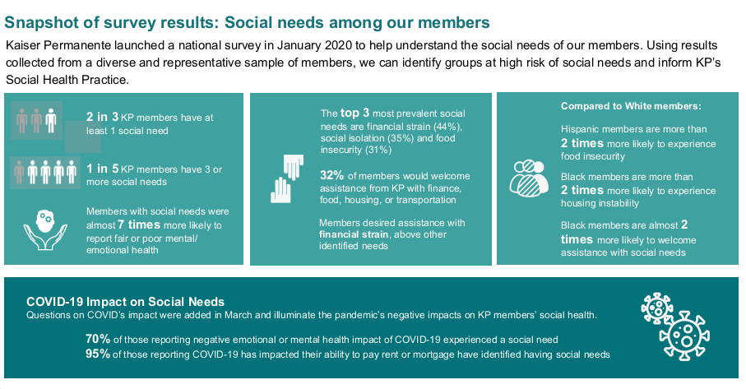
Social Determinants of Health & KP Members
5
From “2020 National Social Needs Survey Final Report” January 2021
Notes:
Slide courtesy of Brian Heller de Leon, Thrive Local
Other key findings from the report:
Half of members would like help with social needs
Members were most interested in having help with debt, loan, credit card repayment, medical care and dental/vision services
1 in 5 members are interested in written information about community resources
1 in 12 members would like someone to talk to help them find community resources

Slide 6
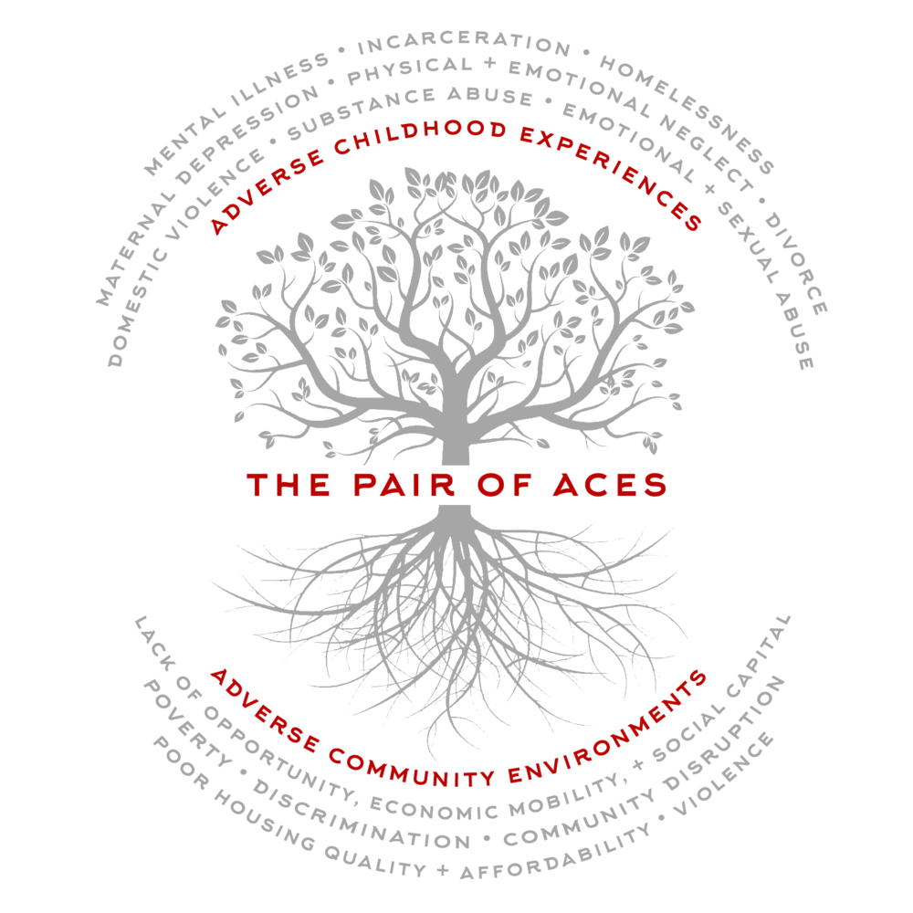
ACES + Social / Behavioral
Determinants of Health
https://.publichealth.gwu.edu
Notes:
The tree is planted in poor soil that is steeped in systemic inequities, robbing it of nutrients necessary to support a thriving community.
https://publichealth.gwu.edu/sites/default/files/downloads/Redstone-Center/Resource%20Description_Pair%20of%20ACEs%20Tree.pdf
https://www.mindfulnessfirst.org/blog/aces-pair-trauma

Slide 7
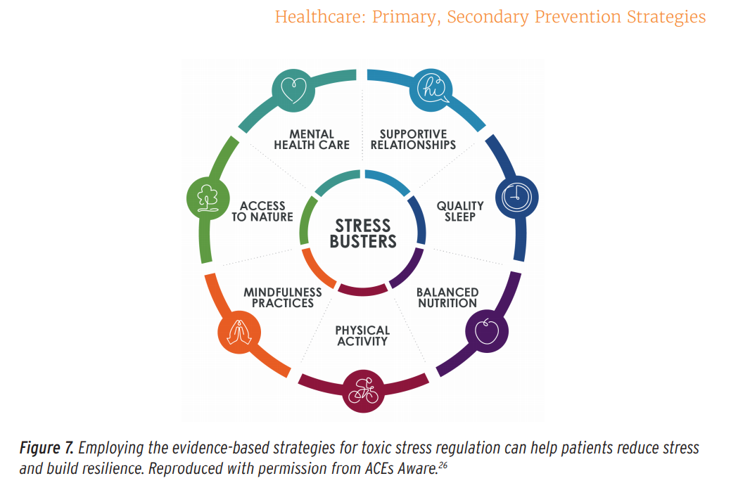
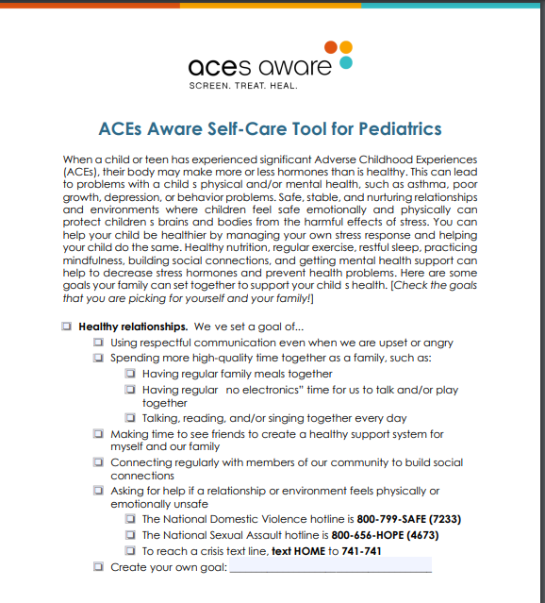
Toxic Stress
Notes:
https://www.acesaware.org/wp-content/uploads/2019/12/Self-Care-Tool-for-Pediatrics.pdf
https://osg.ca.gov/sg-report/
Roadmap for Resilience: The California Surgeon General’s Report on Adverse Childhood Experiences, Toxic Stress, and Health
ACES Aware talk 2.18.21 (Rachel Gilgoff)

Slide 8
Toxic Stress Action Plan
Strategy | LOW RISK ACES = 0 + ASYMPTOMATIC | INTERMEDIATE RISK ACES = 1-2 + ASYMPTOMATIC | HIGH RISK ACES = 3 or SYMPTOMATIC
Healthy relationships | Anticipatory guidance: encourage connection with supportive family, friends, activities. | Talk, Read and Sing Reach out and Read Time in | Community programs and support groups (Single Mom Strong, etc)
Sleep | Anticipatory guidance: encourage good sleep hygiene | Night light, weighted blanket Relaxation techniques | Medications Sleep study if needed Mental Health referral
Nutrition | Anticipatory guidance: Stress can change appetite; increase cravings for unhealthy foods. Western diet associated with increased inflammation; anti-inflammatory diet. | Nutrition support Omega-3 FA supplementation Eat with family/friends, physical activity, mindful eating Trauma-informed weight loss programs
Physical activity | Anticipatory guidance: Improves memory, attention, cognition, mental health, immune function. Promotes positive stress response and resilience. | Brief activity breaks to release excess energy. Moderate intense aerobic activity 3x per week Exercise + self-regulation + breathing (martial arts, yoga) Low mood and stress = barriers to exercise → professional support
Notes:
CALIFORNIA ACES ACADEMY - What Happens After ACEs Screening? 2.18.21 (Rachel Gilgoff)
Roadmap for Resilience 2020 California Surgeon General’s report

Slide 9
The Five Protective Factors
Notes:
These factors strengthen families, optimize child development & reduce child maltreatment
https://cssp.org/our-work/project/strengthening-families/
What We Work For
We engage families, programs, and communities in building key protective factors.
Children are more likely to thrive when their families have the support they need. By focusing on the five universal family strengths identified in the Strengthening Families Protective Factors Framework, community leaders and service providers can better engage, support, and partner with parents in order to achieve the best outcomes for kids.
How We Do It
The Strengthening Families framework is a research-informed approach to increase family strengths, enhance child development, and reduce the likelihood of child abuse and neglect.
We work to engage families, programs, and communities in building the five protective factors. States apply the Strengthening Families approach in early childhood, child welfare, child abuse prevention, and other child- and family-serving systems.

Slide 10
Risk-Stratified Resources
5 PROTECTIVE FACTORS | LOW RISK ACES = 0 + ASYMPTOMATIC | INTERMEDIATE RISK ACES = 1-2 + ASYMPTOMATIC | HIGH RISK ACES = 3 or SYMPTOMATIC
RESILIENCE | .PedsACEresourceschild KP Resilience AVS AAP 3 Rs handout | + Toxic Stress Action Plan Parenting Through COVID-19 (stress management for 6-10) | +
KNOWLEDGE OF CHILD DEVELOPMENT | AAP trauma-informed anticipatory guidance KP Thriving Families blog My Doctor Online CDC website & handouts | + EDSP screening if needed KP Pedi Parenting (0-5) | + Consider PCIT Referral (via Mental Health)
SOCIAL/EMOTIONAL COMPETENCY | AVS/Clinical Library KP Thriving Families blog Baby Navigator website AAP Stop, Drop & Stay in Control | + Parenting Your Young Child Offer Help Me Grow referral (ASQ-SE) | + Behavioral Health referral Help Me Grow referral (ASQ-SE) Positive Parenting class?
SOCIAL CONNECTIONS |  | Offer Community referral | Community referral
CONCRETE SUPPORT IN TIMES OF NEED |  | Offer Community referral Offer Mental Health referral (teens or caregivers) | Community referral Mental Health referral Addiction Medicine tips eConsult CASP Social Worker

Slide 11
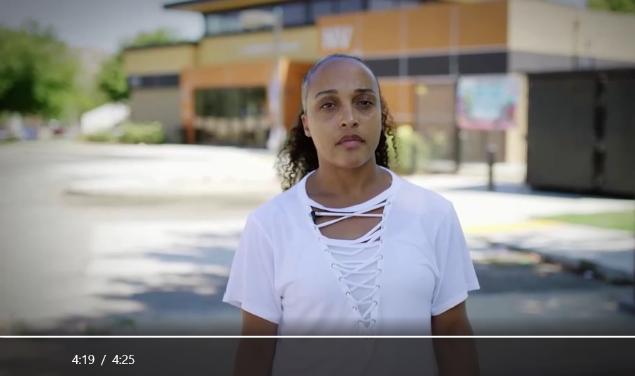
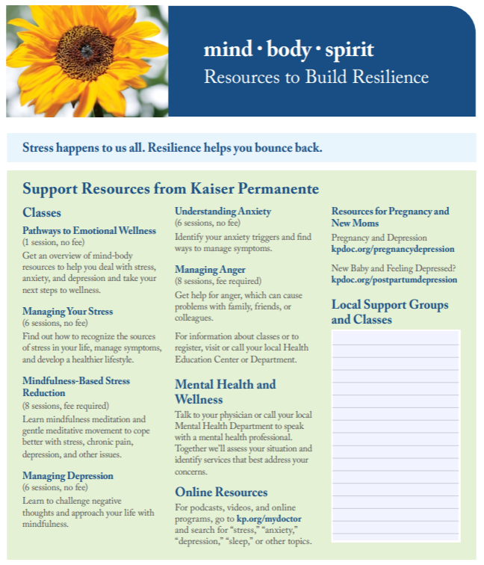
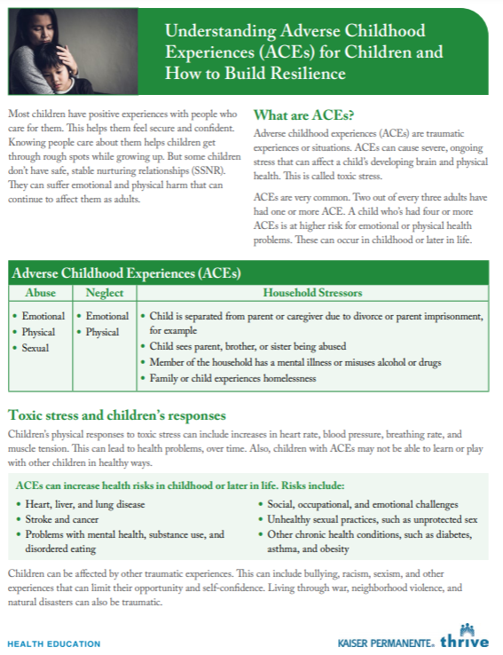
ARTS Development
Regional & Local Planning Teams
  CASP, Thrive Local, Departments of Pediatrics, AFM, Women’s Health
  Local ARTS leads & champions
Training Materials
  Steal-the-Slide decks
  My ACES Story Videos
  Online Modules for docs & staff
Workflow
Technology Tools (KPHC, Abuse & Assault Website)
Provider & Staff Resources
  Communication Tips
Member Tools
  Online & Print Resources
Notes:
“I would like to have had these questions asked when I was bringing kids in, or even more when I was a child. I know how serious this is. I respect what this paper is and means. I know how hard it can be for parents to open up.” – staff quote
Dr. Tanisha Silas-Young ACES Story Video
Length: 4 minutes and 25 seconds
Microsoft Stream Link: https://web.microsoftstream.com/video/98f741a4-2d8a-4029-a015-9b4342a70050
Dr. Christopher Walker ACEs Story Video
Length: 3 minutes and 32 seconds
Microsoft Stream Link: https://web.microsoftstream.com/video/4c081cb7-0054-475a-aca3-d1fb846b9dab

Slide 12
Trauma-Informed Care Coordination
DBP & EDSP
Developmental screening
Handouts & online resources
HEALTH EDUCATION
MENTAL HEALTH
PRIMARY CARE
CASP
WOMEN’S HEALTH
PEDIATRICS
AFM
Classes & Coaching
Handouts & Resources
MediCal GMC
Thrive Local
Counseling
Evidence-based programs
eConsult
Abuse & Assault website
Social worker support
ADDICTION MEDICINE
Treatment & counseling for caregivers & teens
Notes:
2021 Concept Map

Slide 13
Pediatric PEARLS In Clinic Workflow
MEDICAL ASSISTANT
PHYSICIAN
RECEPTION
Patient checks in for annual well check (ages 1-6 yearly, ages 8-17 every other year)
Provide well questionnaire and ACES Resource Handout
Provide PEARLS 1-2 questionnaire and invites caregiver to complete.
Registers patient and updates status on KPHC
ACES Best Practice Alert fires if no record of completed screening in last year, and > 12 months old
Not Completed:
Provides education and offer again
Selects billing code for declination and completes visit without PEARLS
Provides Understanding ACEs AVS
Takes vitals and rooms patient
Notifies MD if unwilling to complete
If completed, opens PEARLS questionnaire in Well Care Smart Set and transcribes scores.
Only Yes responses need to be marked.
Select procedure code and enter authorizing provider (G9920 for 0-3, G9919 > 4)
Completed:
Review scores with caregiver
Screen for safety and symptoms
Create plan

Slide 14
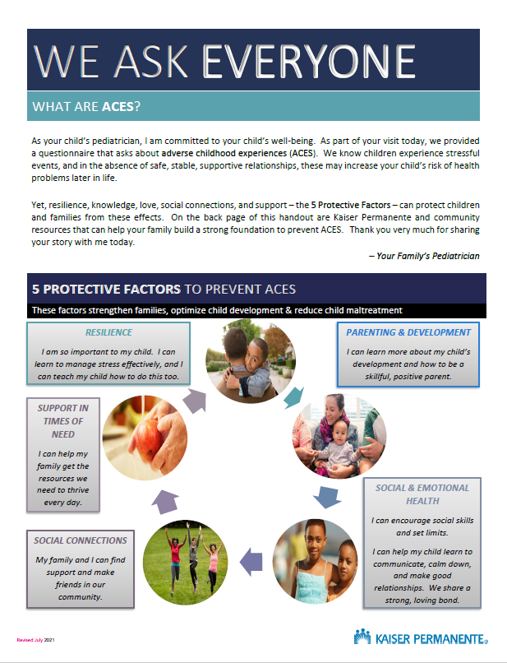
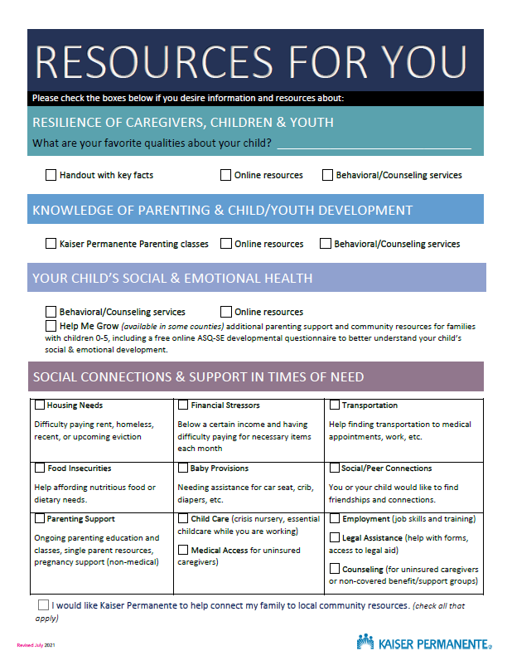
Notes:
NVLY Peds ARTS intro + resource handout

Slide 15












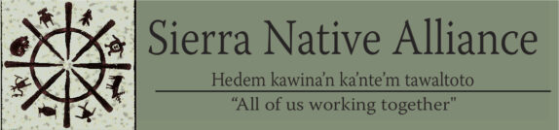
North Valley Community Partnerships
Begin building community partnerships Sacramento, Yolo & Placer Counties
Direct Community Referral Pilots
Rancho Cordova
Downtown Commons
Davis
Launched ACES in Pediatrics
Thrive Local
& Placer County collaborative meetings
Refine community referral workflows
Self-referrals
Social Worker
Spring 2019
Spring 2020 – Spring 2021
Summer 2021
Spring 2022

Slide 16
Lessons Learned
What Works Well:
Proactive ARTS champions outlining process, goals and a timeline for implementation with their clinic’s chief & nurse manager
ARTS champions providing 1:1 training for MD-MA pairs
Check in often and regularly until it becomes part of your workflow
  Weekly check-in at Huddles
  Monthly check-in at clinic meetings
Challenges:
Burn-out → resistance to change.
Parents don’t read the intro letter or fill out the questions truthfully; they are given multiple questionnaires during the busy rooming process.
Questionnaires get lost or are not given out consistently.
How to truly become a trauma & resiliency-informed organization?
Notes:
What didn’t work so well – variable success with higher levels of resistance among docs & staff at certain clinics to add yet another thing to their daily workflow.
Not everyone is as passionate or willing to go the extra mile.
Harry: I think that it’s important to acknowledge that, as challenging as it has been operationalize ACEs screening and to develop/strengthen the resources that we are able to offer, it is a far more challenging endeavor for us to become a truly trauma/resilience-informed organization. Even for departments that have been screening for ACEs for several years, there are still many providers/staff who feel very uncomfortable talking to patients/families about their ACEs/past traumas. That is certainly still true of my own department in the GSAA—something that we are continuing to work on both locally and regionally.

Slide 17
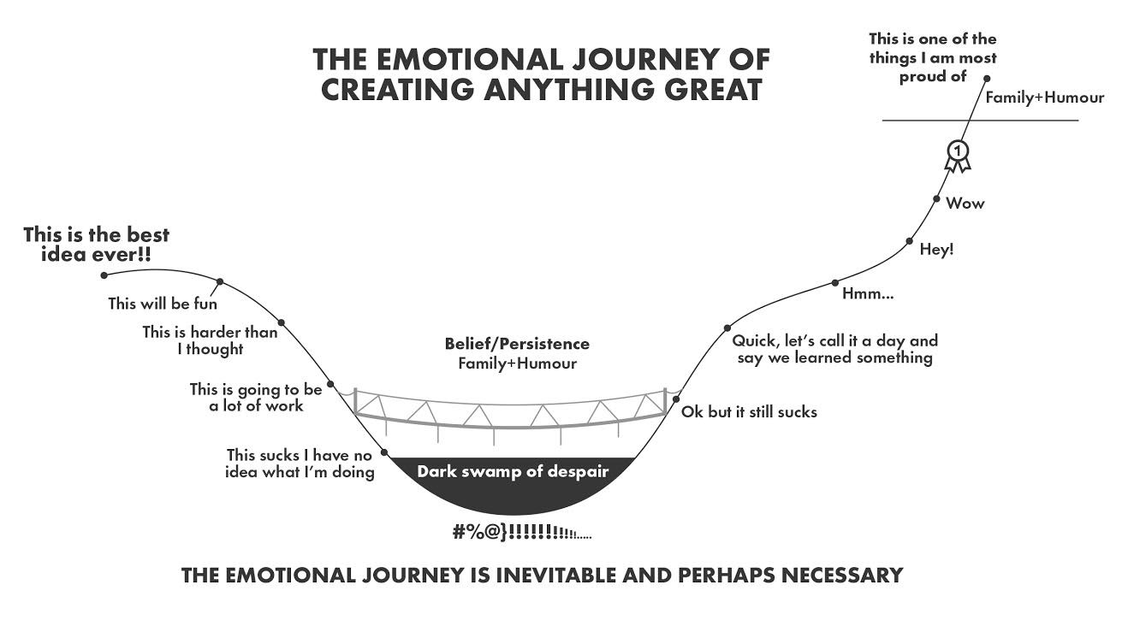
Notes:
This is a process and individuals may be on different places in this journey. Fears and concerns are a part of any change. Share a quote from a patient or show a My ACES Story video.
Permission obtained from John Lee Saddington for use. (Email to Physician Education on 5/11/2021.) https://john.do/emotional-journey-creating/

Slide 18

Ordinary Magic
“Resilience is common, and it typically arises from the operation of normal rather than extraordinary human capabilities, relationships, and resources. In other words, resilience emerges from ordinary magic.”
~ Ann Masten, PhD
Permission to use image from shutterstock.com
Notes:
Slide courtesy of Alicia Ayers

Slide 19
Thank You
KAISER PERMANENTE
Regional CASP: Michele Evans, Armika Berkeley, Daniel Berson, Judy Gee
North Valley CASP: Alicia Ayers, Lanette Robles, Jessica Myers
South Sacramento Pediatrics: Erin Gonzales, Yvonne Otani
NVLY Pediatrics Chiefs, Nurse Managers, IT Support
Thrive Local: Brian de Leon, Cheryl Dilbeck
Behavioral Health: Danielle Wells, Rachael Villegas
Health Education: Alisha Reynolds, Jennifer Sanders, Olivia Thomas
DBP/EDSP: Meghan Davignon, John Salvato, Symone Sabath
COMMUNITY PARTNERS
CAP-C (Child Abuse Prevention Council)
Help Me Grow Sacramento
Birth & Beyond Collaborative
Yolo County Children’s Alliance
Kids First, Placer First 5, Lighthouse, Sierra Native Alliance,
Unite Us
RESOURCES
Roadmap for Resilience: The California Surgeon General’s Report on Adverse Childhood Experiences, Toxic Stress, and Health https://osg.ca.gov/sg-report
ACES Aware www.acesaware.org
Strengthening Families https://cssp.org/our-work/project/strengthening-families/
ACES Too High https://acestoohigh.com/
CDC- Kaiser Permanente ACES Study: Dr. Vincent Felitti et al
AAP Trauma Toolkit for Primary Care Providers
Putting Your Trauma Lens On: Dr. Heather Forkey, AAP

